Slide 1
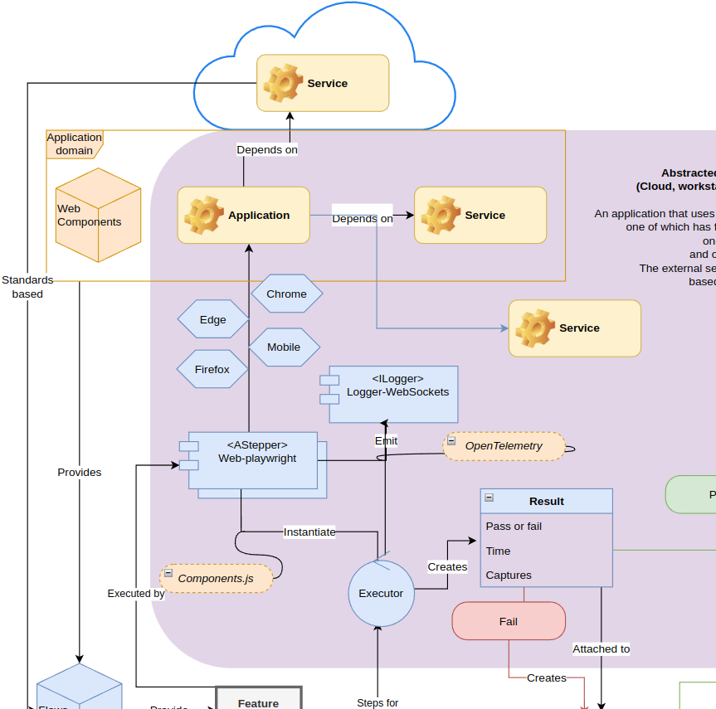
Haibun End to end test driven development in abstracted environments
Using Haibun to test GCXchange pages August 18, 2023
Overview diagram

Slide 2
The idea
Use Haibun to incorporate accessibility (and other) tests into GXChange development
Real time tests during dev, during build and deployment pipelines (with recordings)
Best practices, demonstrate & document flows, catch problems before they’re baked in
Long term - save time, reproducible systems

Slide 3
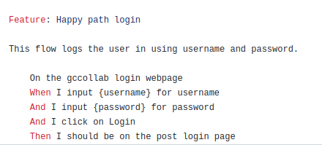
What it would look like
Write scripts for each flow, bootstrapped from business decisions
Run them locally during dev
Incorporate in pipelines for builds, releases
Review issues in build review
Keep release reviews
Automatically create assigned issues for problems

Slide 4

The technical (corporate) challenge
GCXchange is largely based on MS Sharepoint components, environment
Many base components aren’t accessible
https://www.nationalgeographic.com/adventure/article/how-sport-climbing-is-helping-to-revitalize-a-greek-island

Slide 5
GCXchange is largely based on MS Sharepoint components, environment
Developer workstation that can run Haibun (node, playwright)
Pipelines that can incorporate it
Login - 2fa?

